Slide 1
ECOMMERCE OLIST STORE ANALYSIS

Slide 2
INTRODUCTION:
Domain: E-commerce
Project Name: Olist Store Analysis
Tools: Excel, Power BI, SQL, Tableau
Business Problem: Declining customer retention and unclear sales trends.
Goal: Identify sales patterns and customer behavior to improve revenue.

Slide 3
DATA OVERVIEW:
Olist is a Brazilian e-commerce platform that streamlines the platform between various businesses and vast network of online retailers.
The datasets offers a comprehensive view of its operations, including a wide range of information such as orders, products, customer details, seller data and product details.
Size :~ 30,0000 Rows across all files along with their sheets .
Key Columns: Order_ID, Order_Date, Product_Category, Payment_value, Review_score.
Aggregations : Total Orders 99224 , Total Products 112650, Total Customers 99441 and Total Price 13.6M.

Slide 4
OBJECTIVES-KPIS:
Weekday Vs Weekend (order_purchase_timestamp) Payment Statistics
Number of Orders with review score 5 and payment type as credit card.
Average number of days taken for order_delivered_customer_date for pet_shop
Average price and payment values from customers of sao paulo city
Relationship between shipping days (order_delivered_customer_date - order_purchase_timestamp) Vs review scores.
Average shipping day by review Score.
Top 10 Product Category by Number of Orders

Slide 5
PROCESS:
Data Collections.
Data Cleaning: Replacing Null Values, Deleting Columns, Add columns using VLOOKUP Function.
Data Transformation: Created new metrics.
Visualization: Power BI, Tableau.
Insight Extraction.

Slide 6
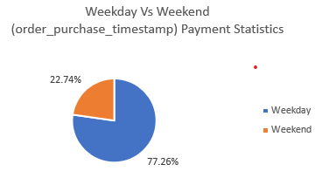
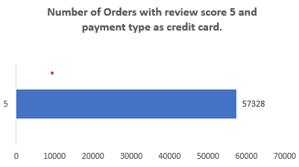
ANALYSIS:
The chart shows that 77.22% of purchases occur on weekdays, while only 22.78% happen on weekends. This indicates that customers are significantly more active during weekdays, suggesting a higher engagement with online shopping during workdays.
The chart shows 57,328 orders with a 5-star review paid via credit card, indicating strong customer satisfaction with this payment method. It suggests that credit card transactions may contribute to a smoother and more reliable shopping experience.

Slide 7
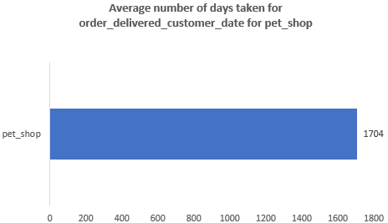
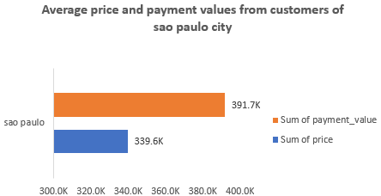
ANALYSIS:
The chart shows that the average delivery time for pet_shop orders is 1,704 days, which is unusually high. This likely indicates a data issue or error in date recording that needs to be investigated and corrected.
The chart shows that customers in São Paulo paid a total of 391.7K, while the total product price was 339.6K. This indicates that customers paid significantly more than the listed prices, likely due to additional charges like shipping or fees.

Slide 8
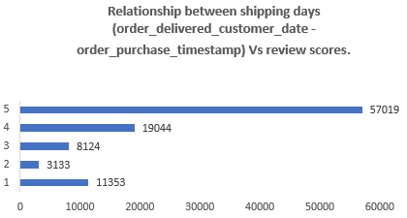
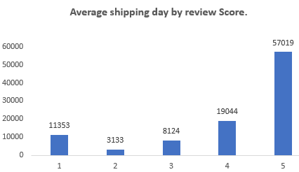
ANALYSIS:
The chart shows that orders with faster shipping times tend to receive higher review scores, with 57,019 5-star reviews. As delivery time increases, review scores drop, indicating a strong link between prompt delivery and customer satisfaction.
The chart shows that higher review scores are associated with a greater number of orders, especially for score 5 with 57,019 shipments. This suggests that timely or satisfactory deliveries likely contribute to better customer reviews.

Slide 9
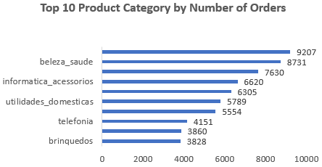






ANALYSIS:
The chart shows that beleza_saude (beauty and health) is the most ordered product category, followed by informatica_acessorios and utilidades_domesticas. This indicates strong customer demand for personal care, tech accessories, and household items.

Slide 10
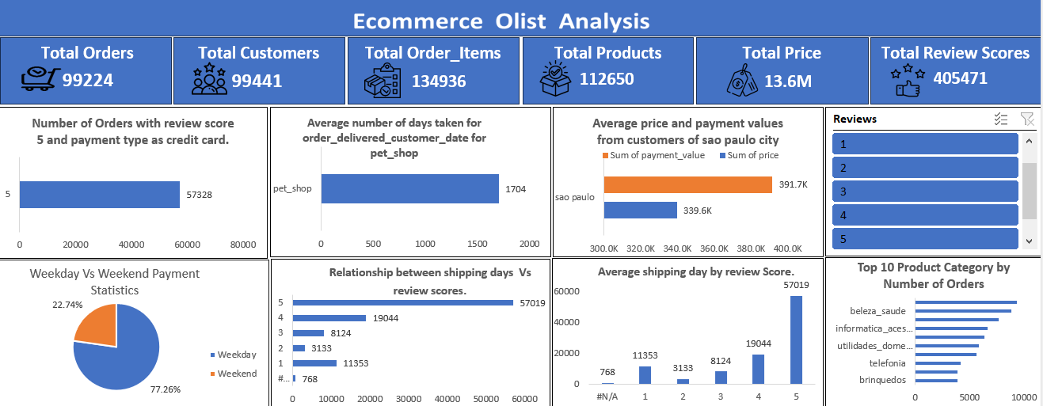
REPORT:

Slide 11
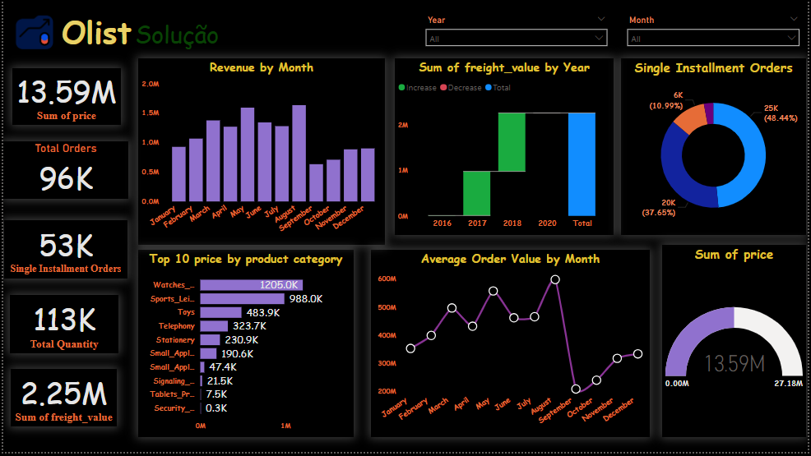
Power BI Report: Olist Sales & Customer Trends

Slide 12
💰 Revenue Trends
Achieved a total revenue of 13.59M BRL, with strong
performance in May, July, and April.
A noticeable dip in September and October suggests
possible seasonal or operational challenges. ✅ Opportunity: Launch targeted campaigns during
off-peak months to stabilize revenue flow
🚚 Freight Cost Insights
Total freight spend stands at 2.25M BRL.2018
marked a major increase, followed by stable
freight values through 2020.
✅ Recommendation: Assess shipping efficiency
and renegotiate carrier contracts to optimize
costs.
📦 Order & Payment Behavior
96K total orders, with over 55% completed via
single installment payments.
✅ Insight: Customers prefer straightforward transactions — consider reinforcing this with incentives for one-time payments.

Slide 13
🏷️ Top-Selling Categories
Leading revenue generators:
Watches (1.2M BRL)
Sports & Leisure (988K BRL)
Toys (484K BRL)
categories like Security and Tablets lag behind.
✅ Strategy: Double down on high performers and reevaluate or reposition low-value categories.
📈 Average Order Value (AOV) Patterns
AOV peaks in May, July, and August, but drops in
October and November.
✅ Action Plan: Introduce bundled offers or upsells in lower-AOV months to boost per-order value.
📊 Revenue Performance at a Glance
The gauge reveals a total revenue of 13.59M BRL,
reaching 50% of the projected maximum
(27.18MBRL)
While this reflects a solid base, it also highlights
untapped revenue potential.

Slide 14
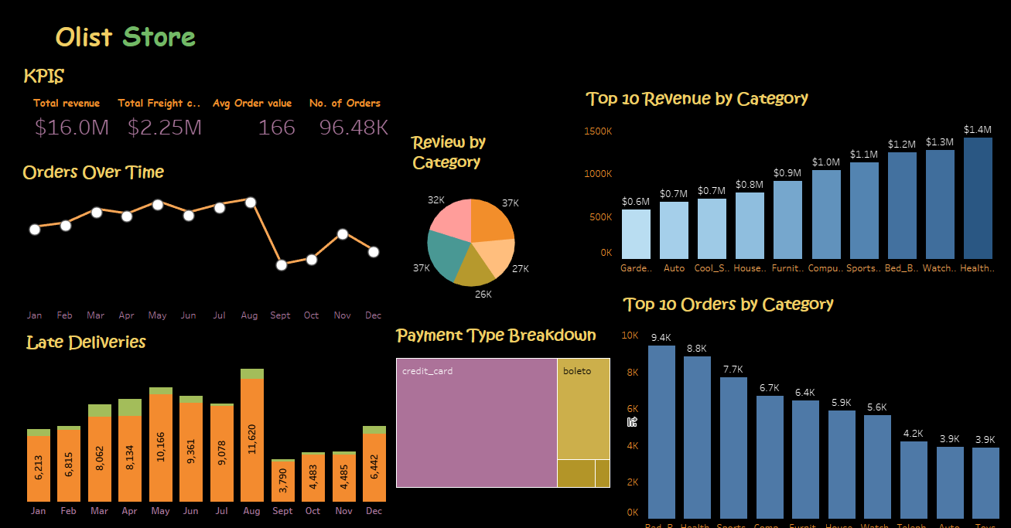
Olist Store Business Pulse – A Tableau Overview

Slide 15
🛍️ Category Insights – What Sells vs. What’s Popular
🥇 Top Revenue Categories:
🧴 Health & Beauty – $1.4M
⌚ Watches – $1.3M
🛏️ Bed & Bath – $1.2M
📦 Top Order Volume:
🛏️ Bed & Bath – 9.4K
🧴 Health & Beauty – 8.8K
🪑 Furniture – 6.7K
🔍 Insight:
"Some categories like Watches punch above their weight – fewer orders, higher revenue. Premium play at work.“
💳 Payment Preferences – What Customers Choose.
Headline:
💡 Credit cards dominate — simplicity and trust lead the way.
Breakdown:
Credit Card – Primary method (most customers)
Boleto – Secondary but far behind
Others – Minimal usage
🧠 Narrative Tip :"Encouraging alternate payment modes (like instant pay or wallet integrations) could broaden appeal."

Slide 16
🚨 Late Deliveries – Operational Pressure Points
Headline:
🚧 Delivery delays spiked alongside order volume.
📦 August had the highest late deliveries (11.6K) – matching the order peak
📉 Delays dropped sharply post-August — likely due to fewer orders
💡 Insight Box :
Late delivery patterns clearly mirror volume surges. Strategic logistics scaling is key during high-demand periods.
📈 Orders Over Time – Volume Trends
Headline:
📉 Order flow reveals strong early-year growth and
Q4 recovery.
Key Patterns:
📈 Growth from Jan,–Aug peaking in August
❗ Sharp drop in September, possibly due to operational or promotional slowdown
🔄 Recovery in Oct–Dec suggests strong seasonal resilience
🧠 Narrative Tip for Presenting :
"While Q3 took a dip, Q4 rebounded impressively — a great indicator of brand loyalty and recovery agility."

Slide 17
CONCLUSION:
📌 Strategic Recommendations
1. Scale Logistics: Invest in fulfillment agility during peak months to reduce delivery delays.
2. Optimize Category Mix: Shift budget toward premium, high-conversion categories for better margins.
3. Payment Innovation: Introduce payment incentives or one-click checkout to reduce friction.
4. Seasonal Preparedness: Plan campaigns around Q3 to maintain momentum and avoid dips like September.

Slide 18
THANK YOU ☺

